Slide 1
Student Management System (SMS)
Rohit Ranjan
2001CS56
BTP Supervisor
Dr. Mayank Agarwal

Slide 2
Problem Statement
At IIT Patna, we currently manage various online services through separate modules. However, this approach presents challenges for our students, who must remember multiple links and log in separately for concurrent access.
To enhance convenience and user-friendliness, we propose implementation of a comprehensive Student Management System. This system will integrate all existing functionalities into a single, all-in-one platform, for our students.

Slide 3
Student Portal
Hostel room request
Fee payment
Contact
Inbox
Room change
Comprehensive Features and Functionalities

Slide 4
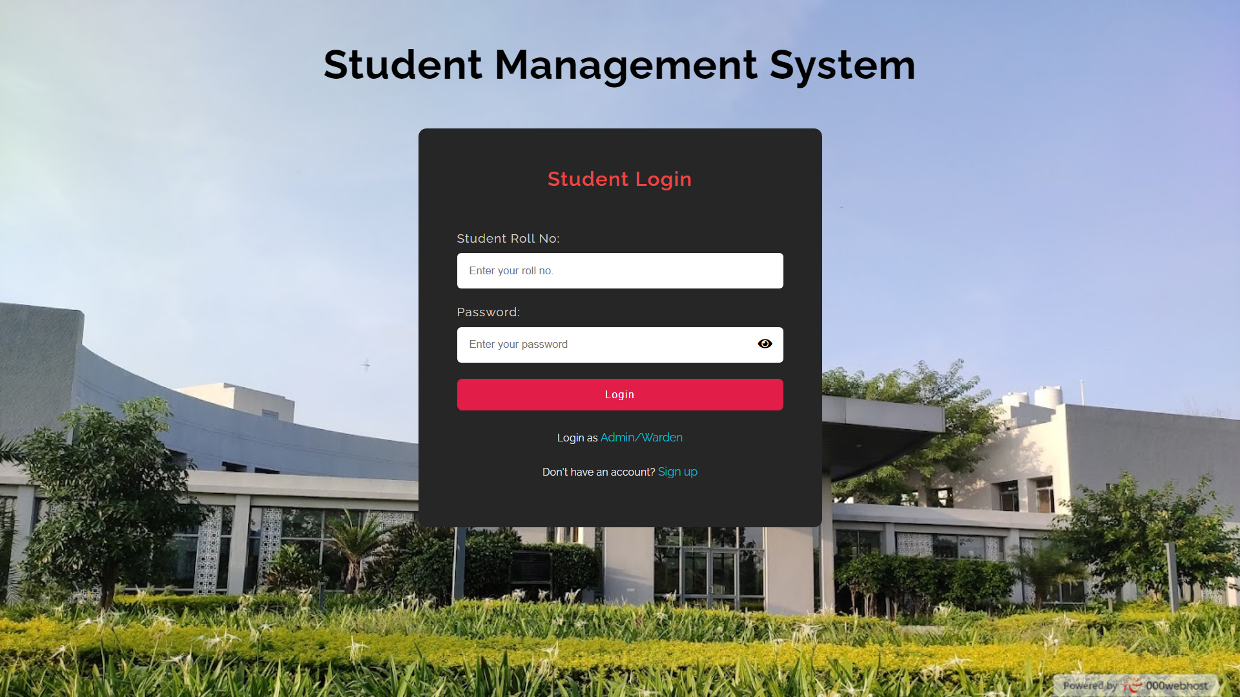

Slide 5
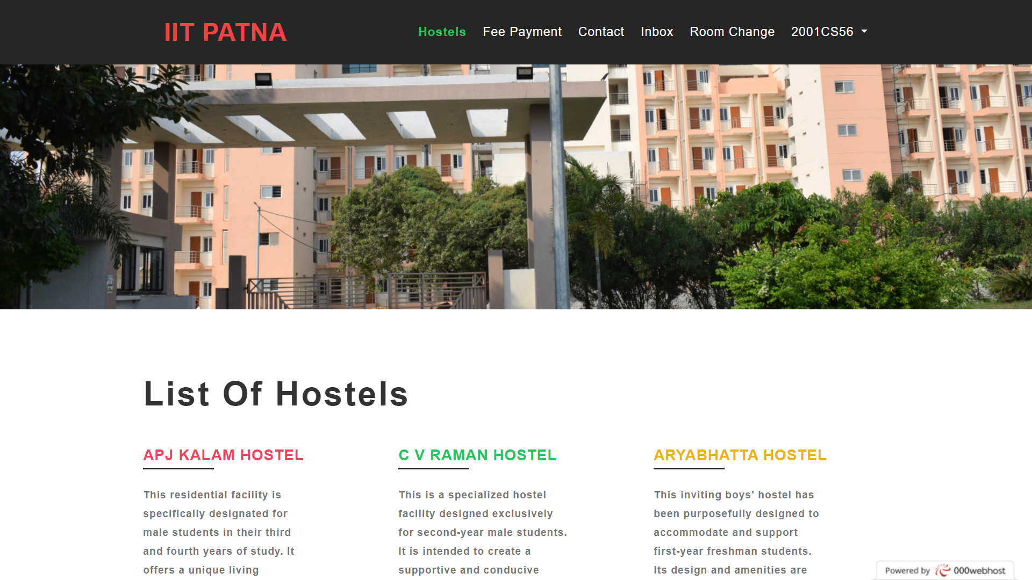

Slide 6
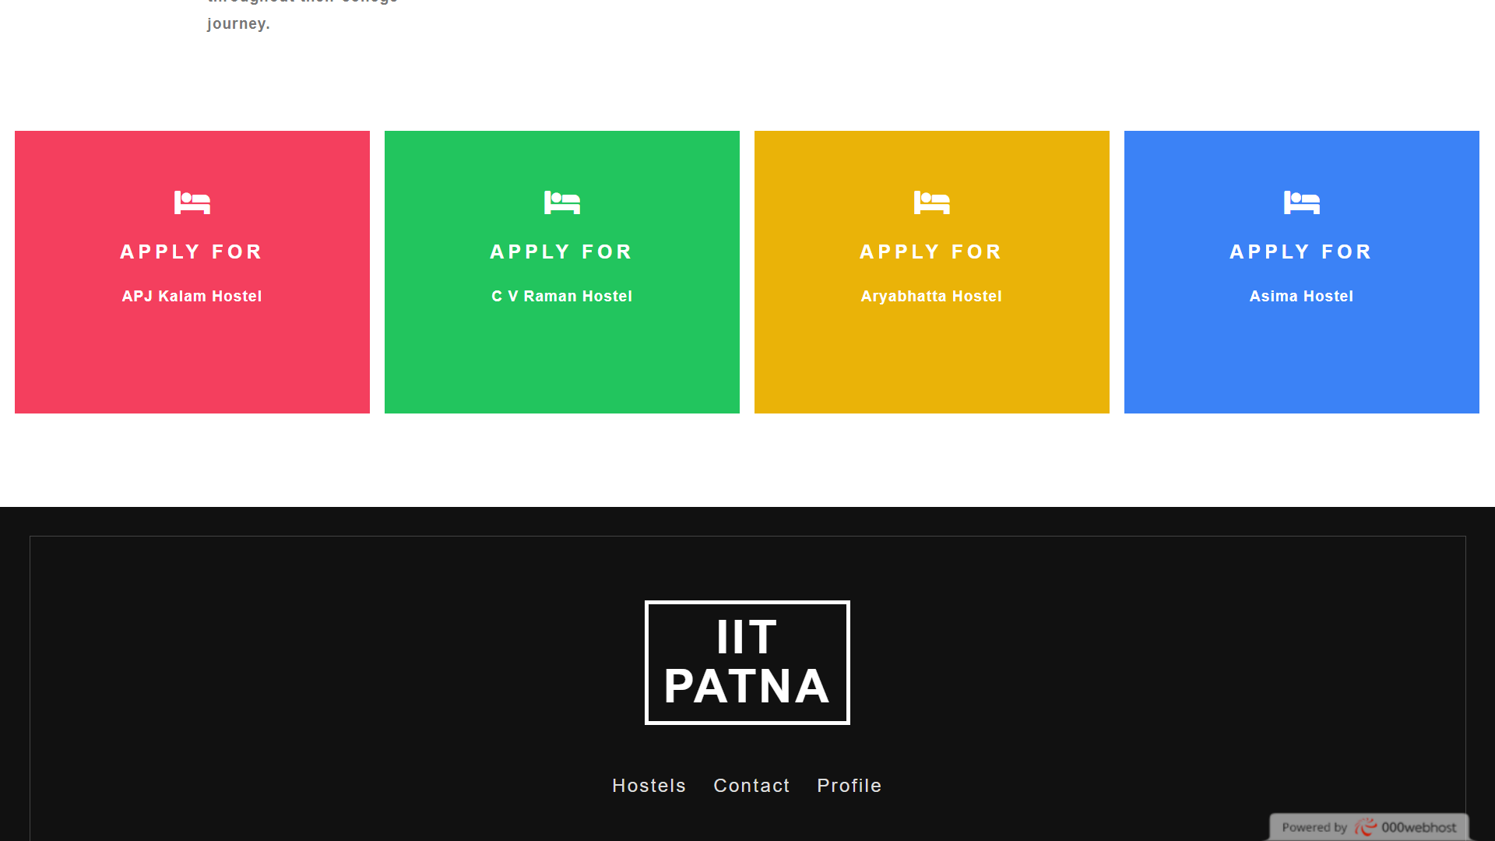

Slide 7
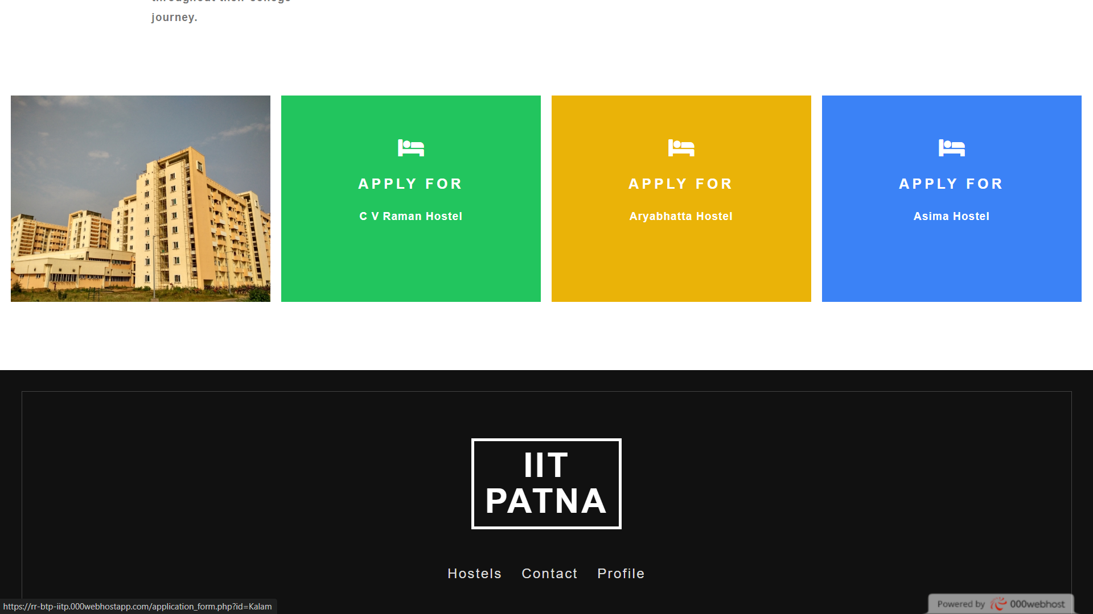

Slide 8
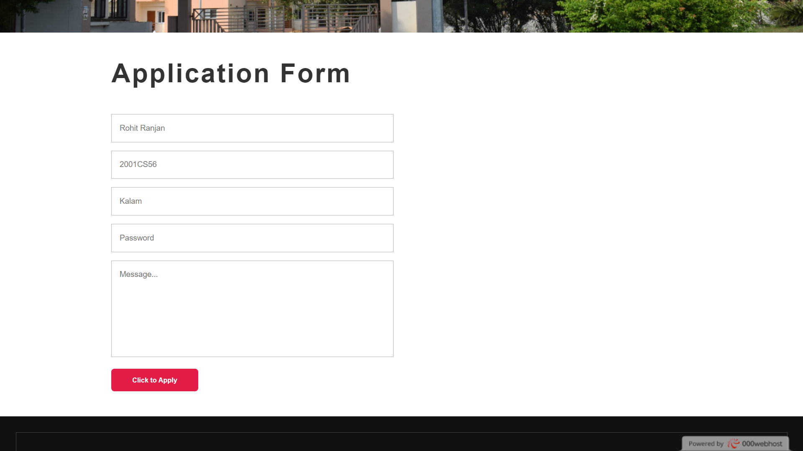

Slide 9
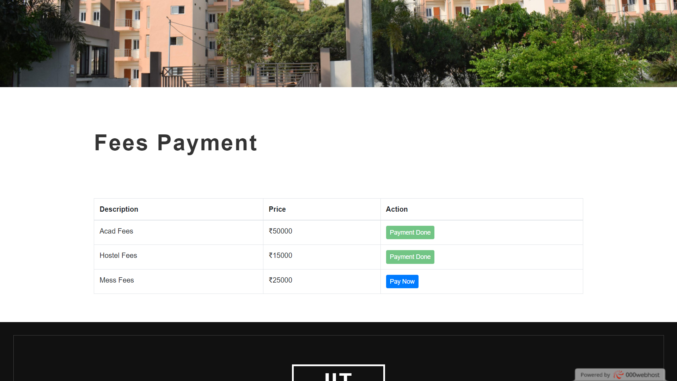

Slide 10
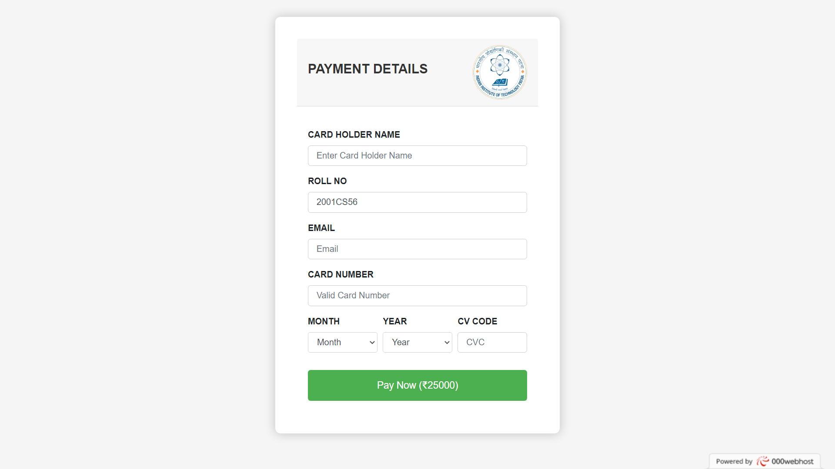

Slide 11
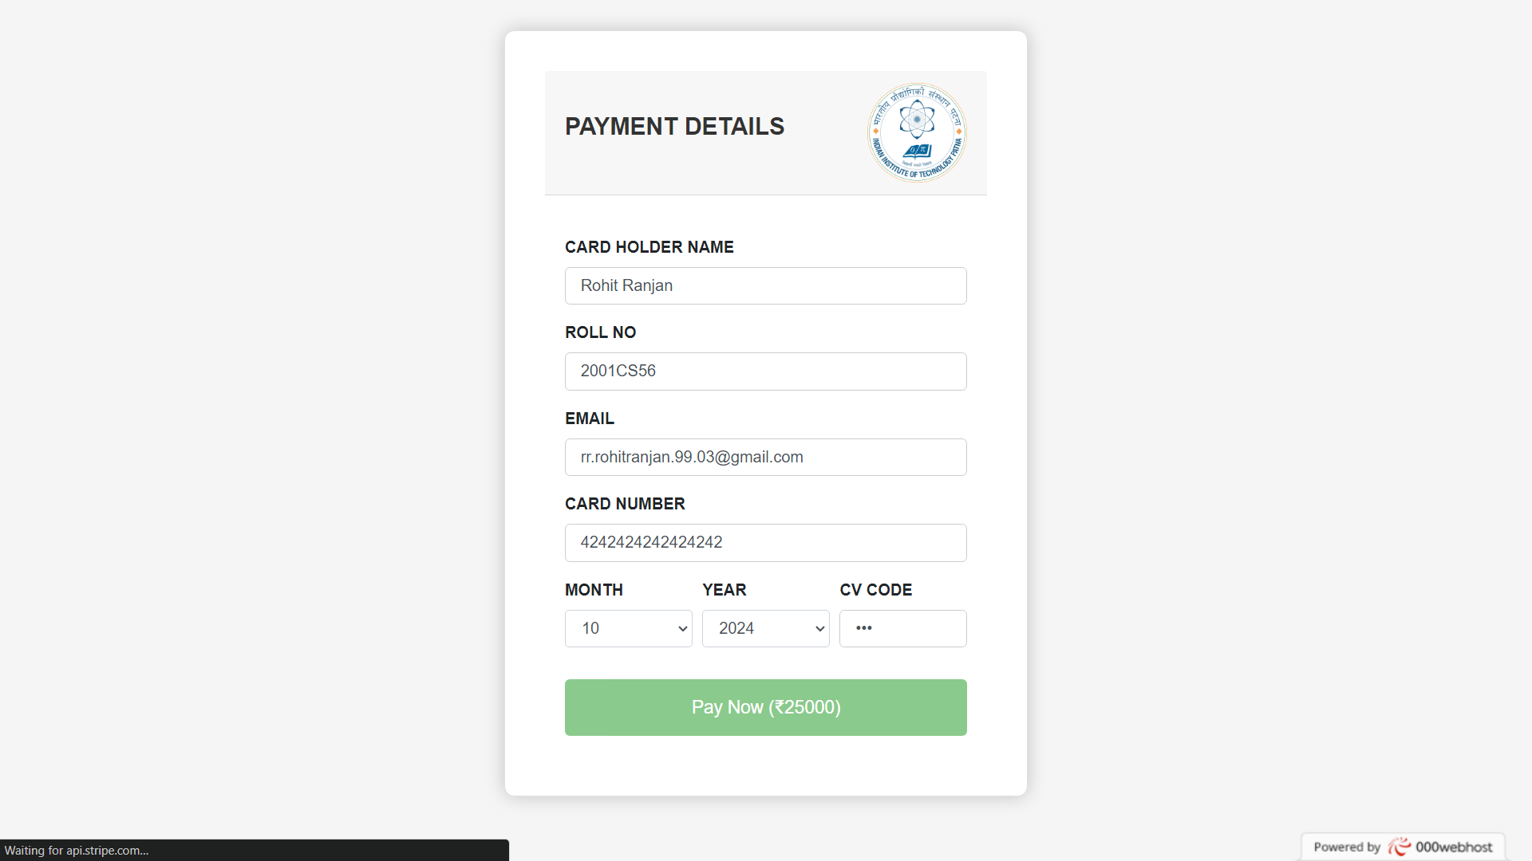

Slide 12
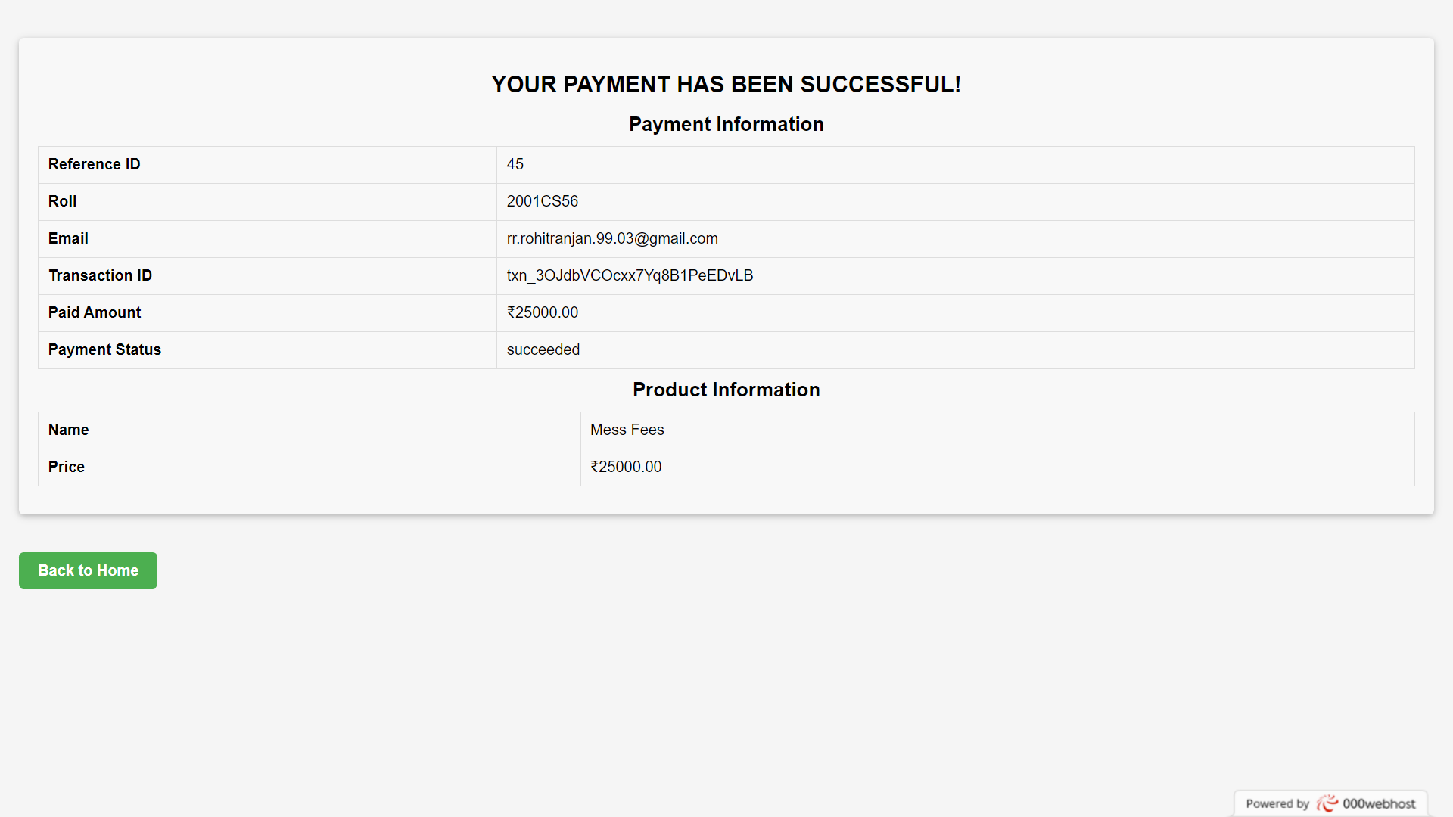

Slide 13
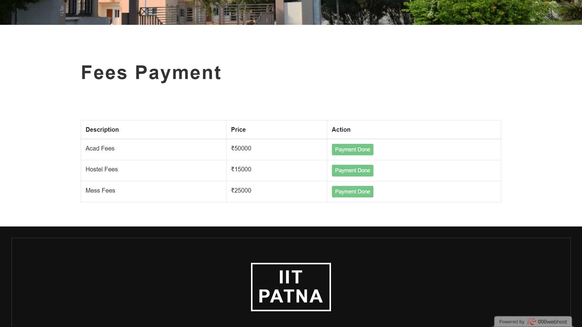

Slide 14
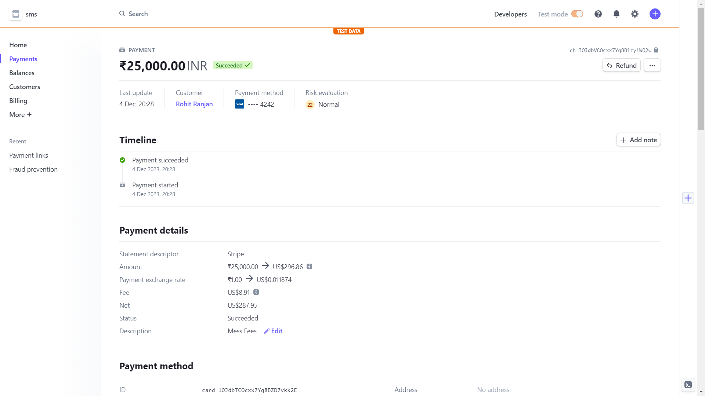

Slide 15
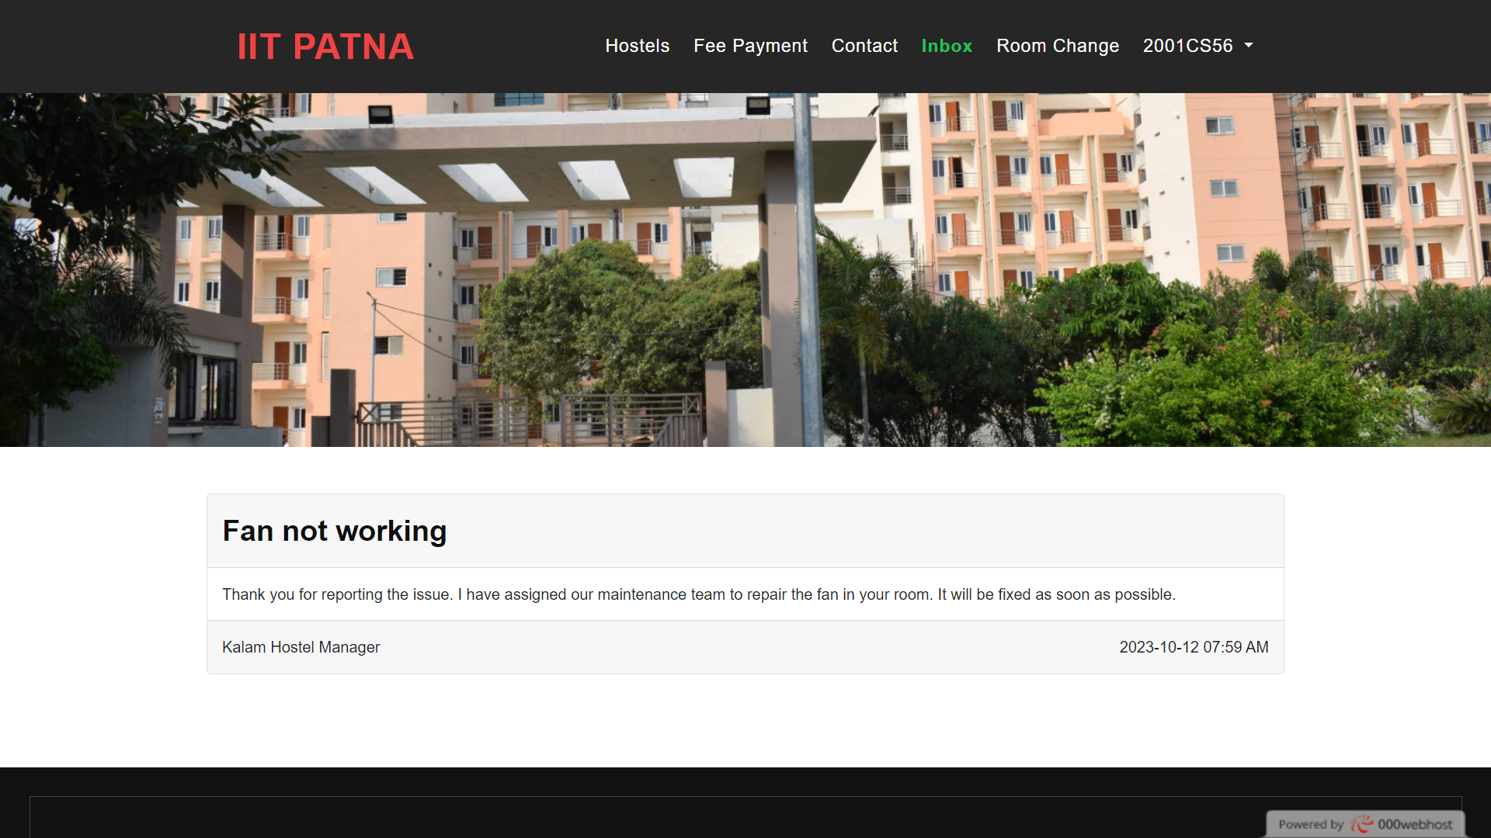

Slide 16
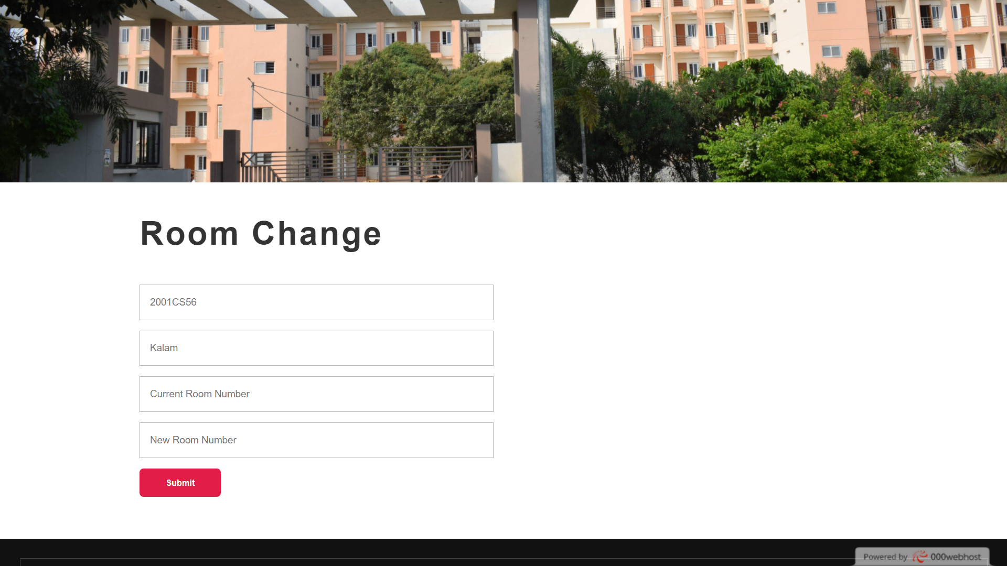

Slide 17
Warden Portal
Allocate room
Inbox
Allocated rooms
Empty rooms
Vacate rooms
Room change request
Reply to student
Comprehensive Features and Functionalities

Slide 18
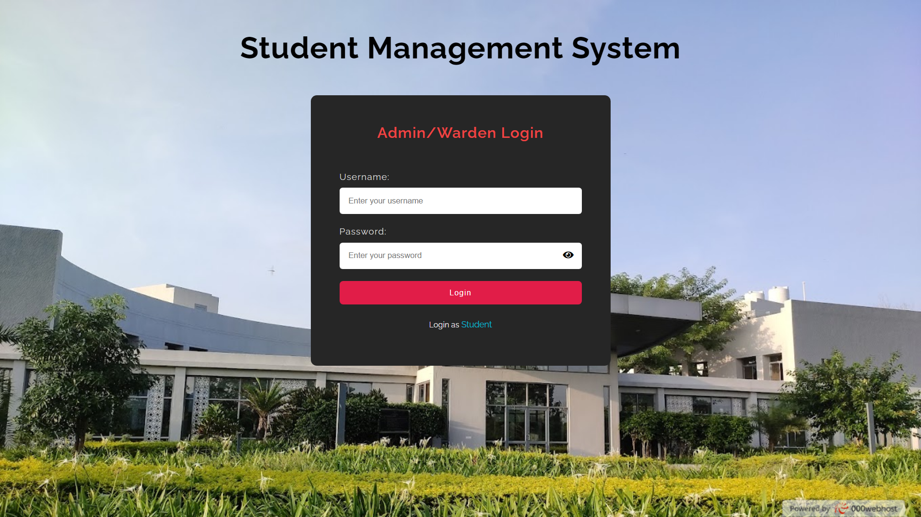

Slide 19
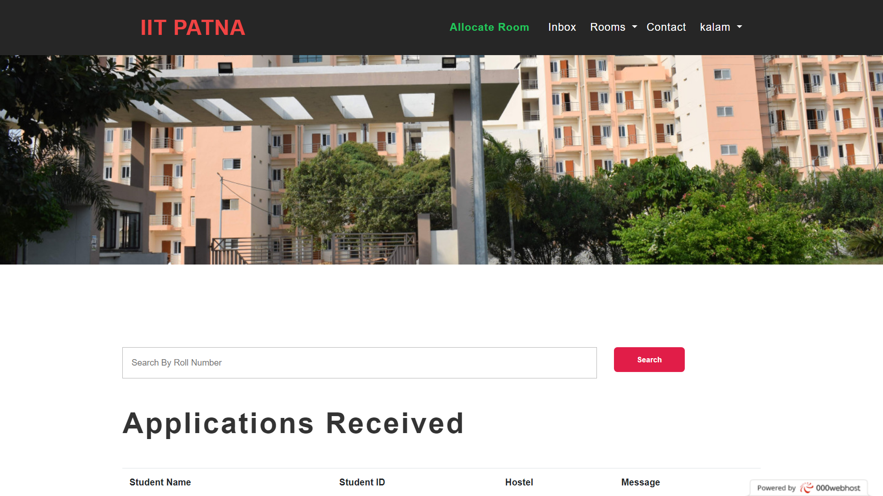

Slide 20
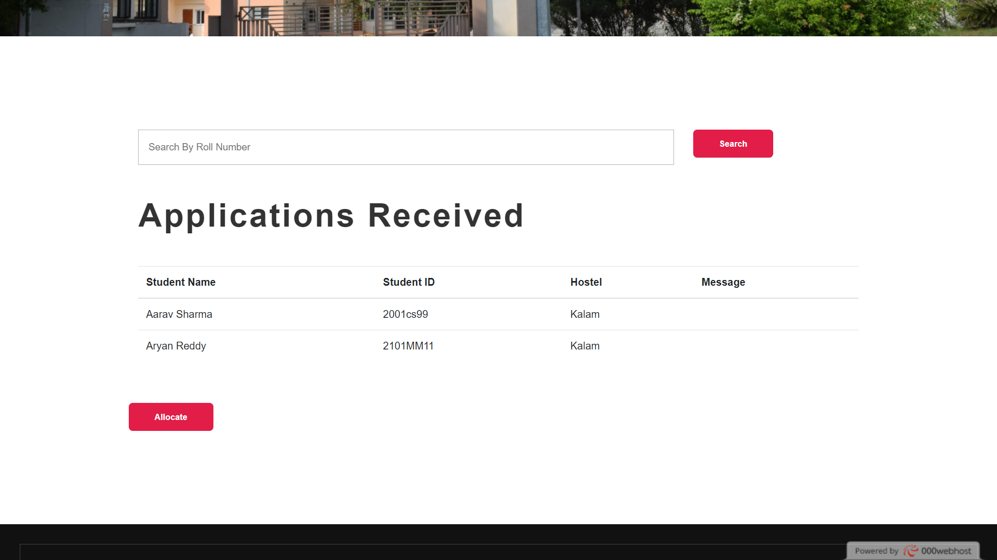

Slide 21
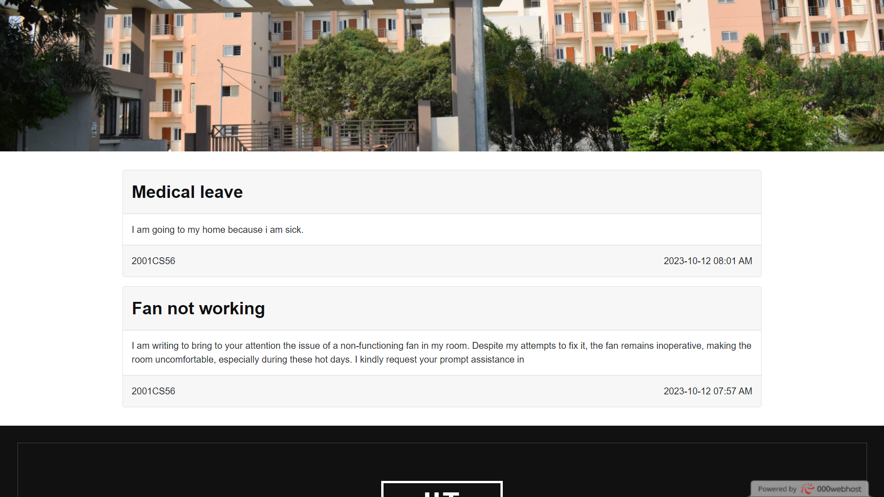

Slide 22
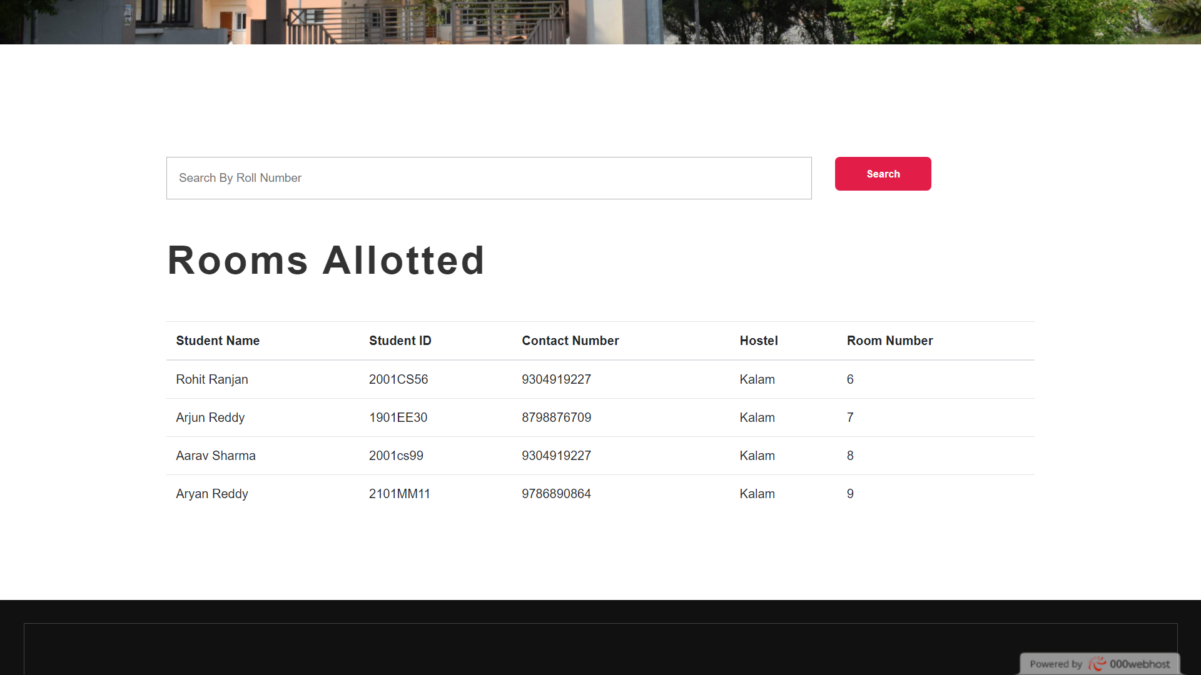

Slide 23
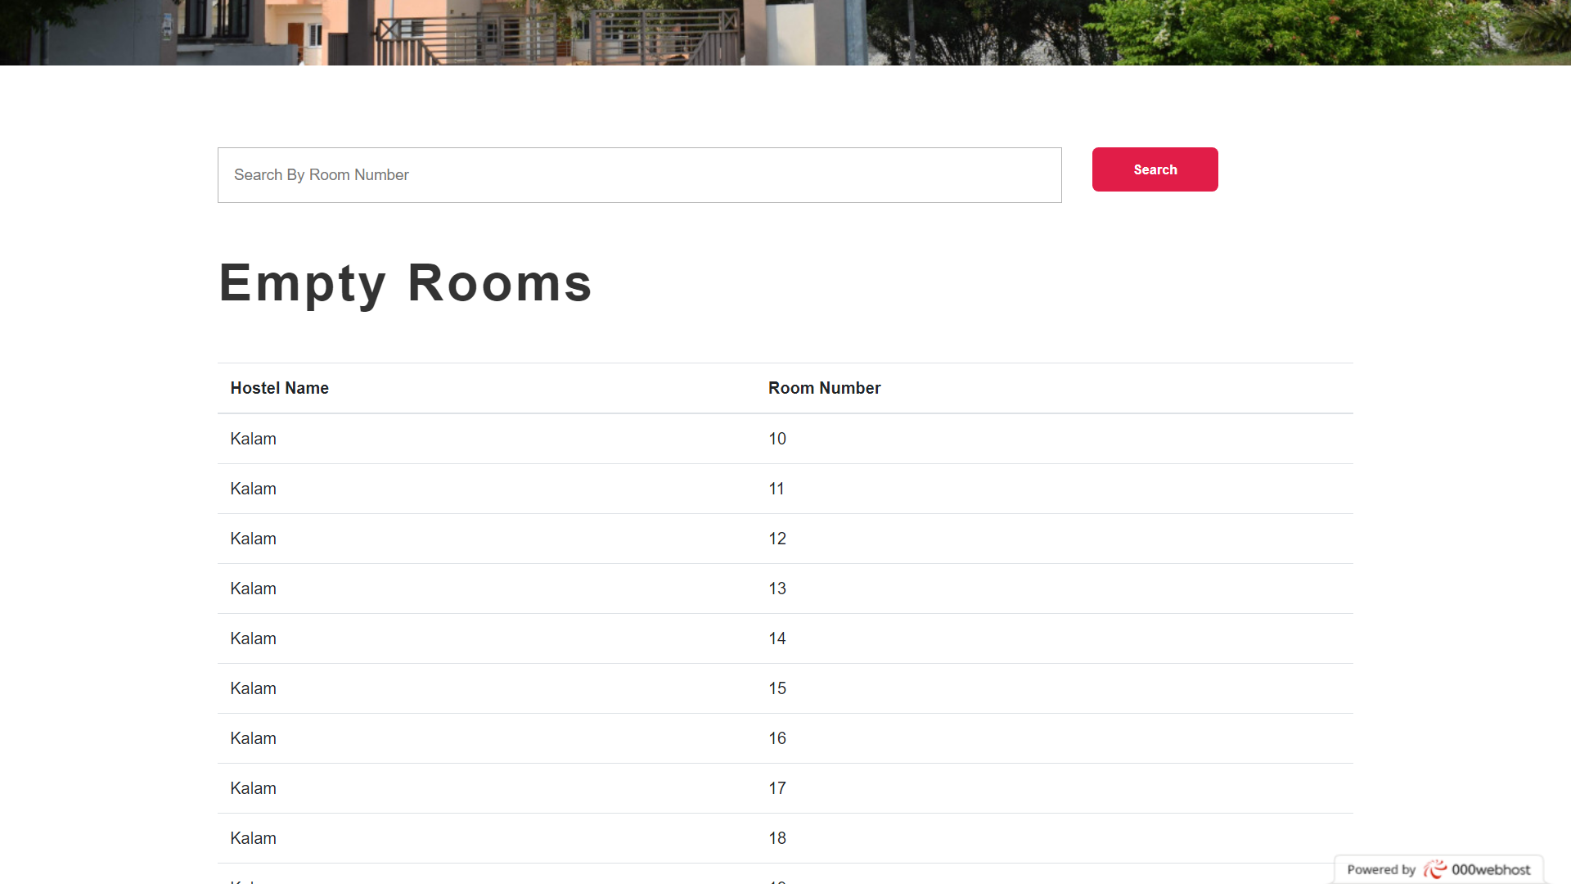

Slide 24
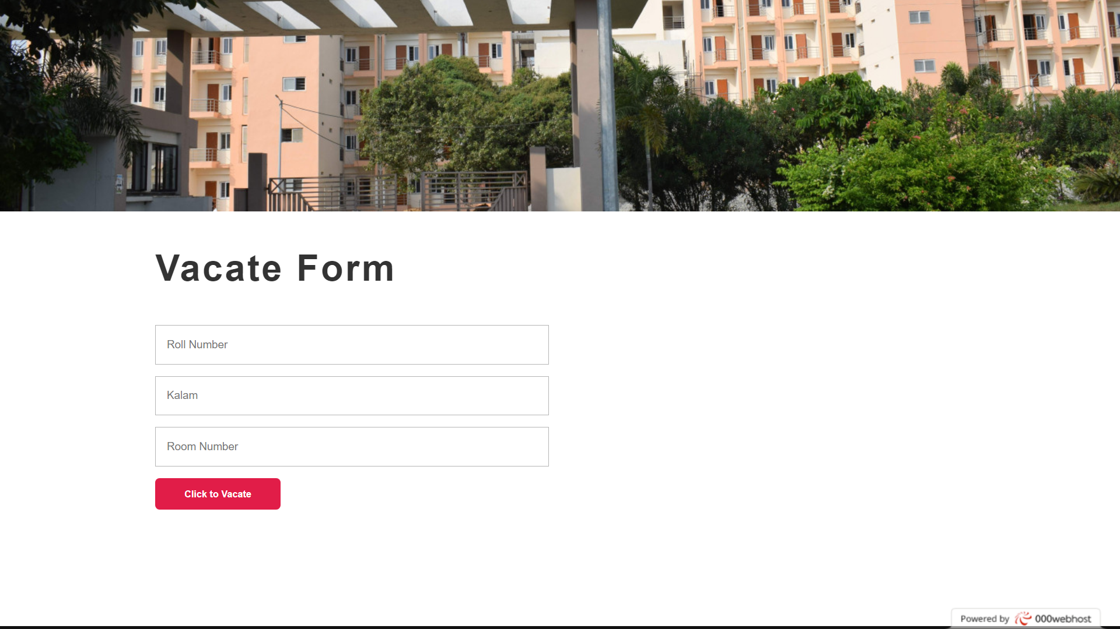

Slide 25
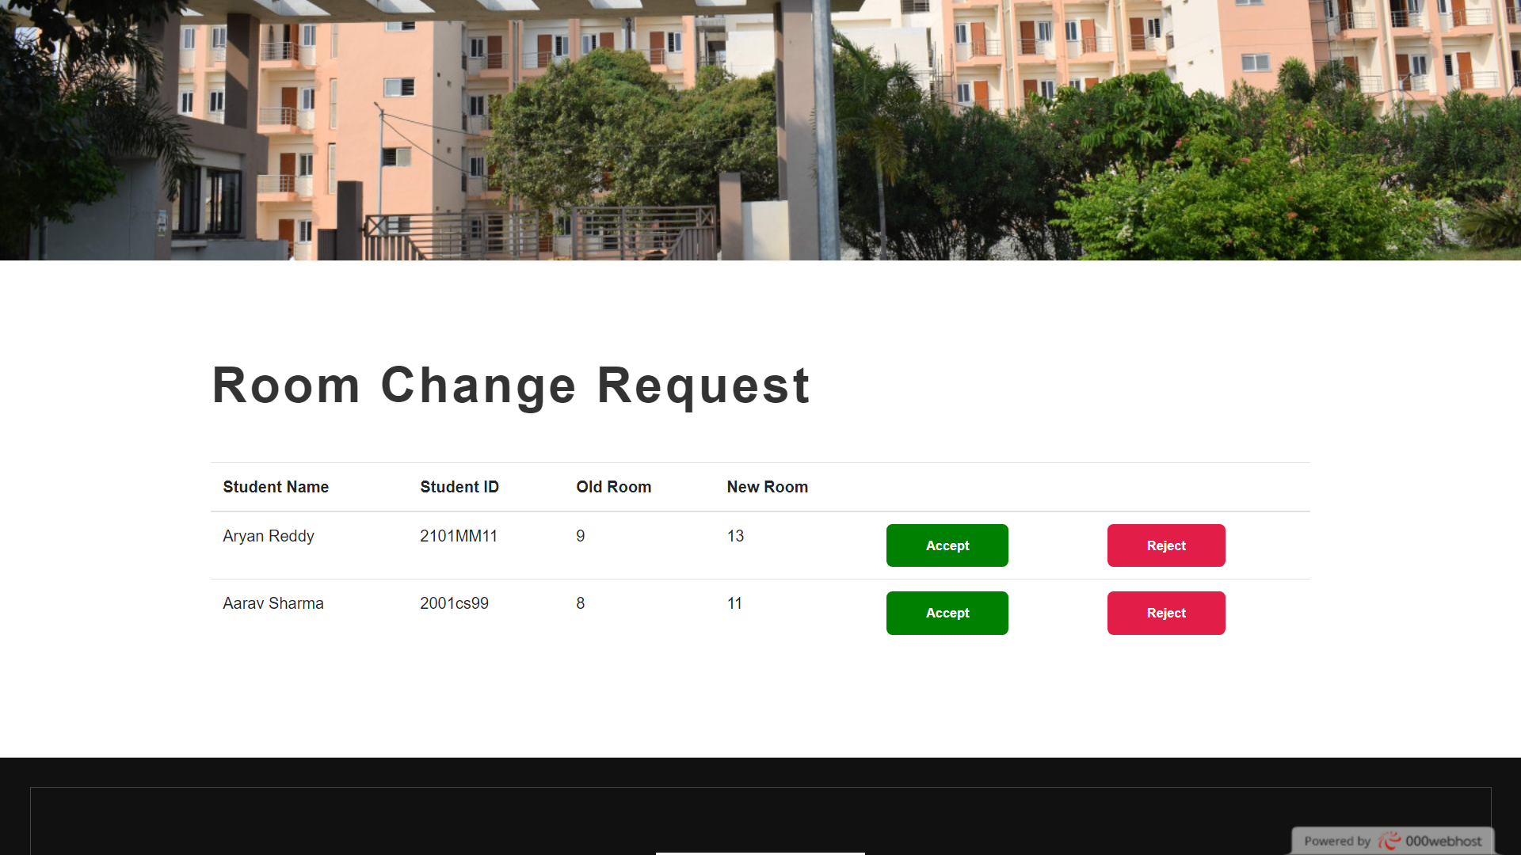

Slide 26
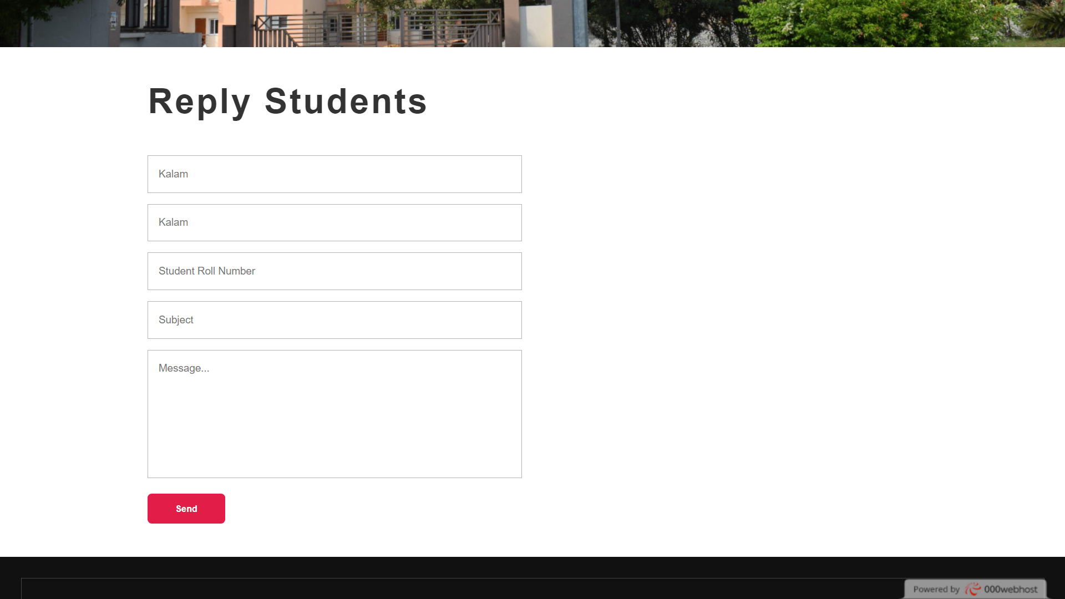

Slide 27
Admin Portal
Appoint warden
Remove warden
Student room details
Fees status
Comprehensive Features and Functionalities

Slide 29
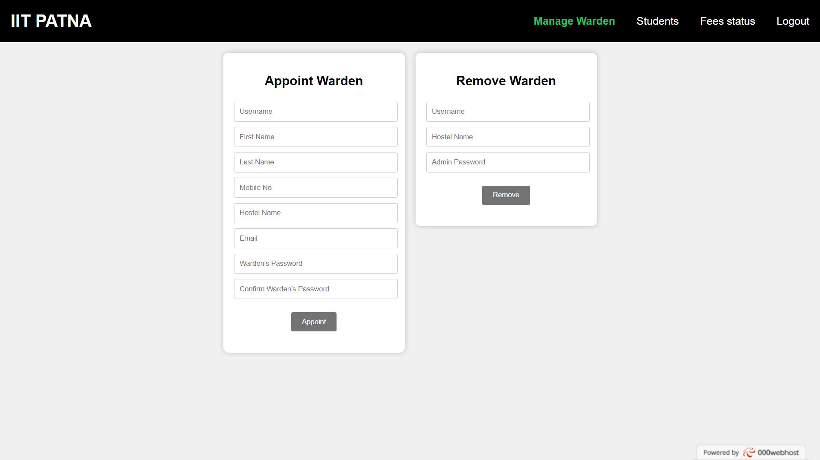

Slide 30
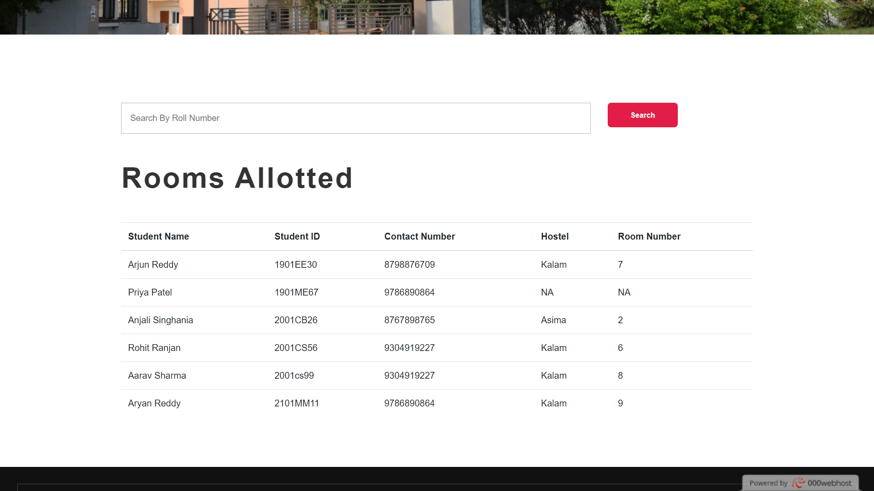

Slide 31
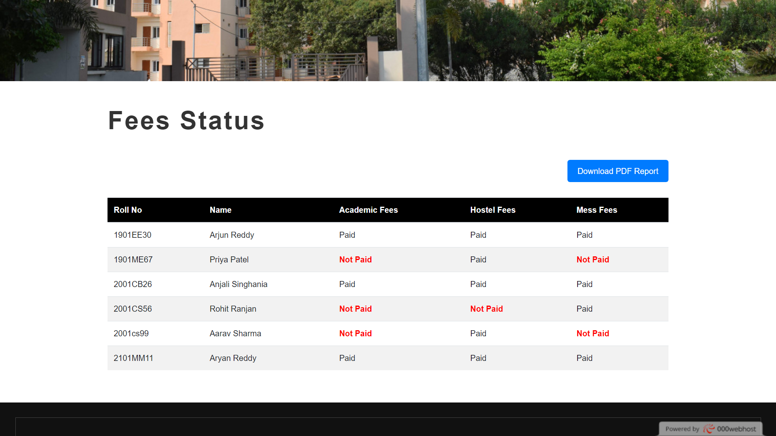

Slide 32
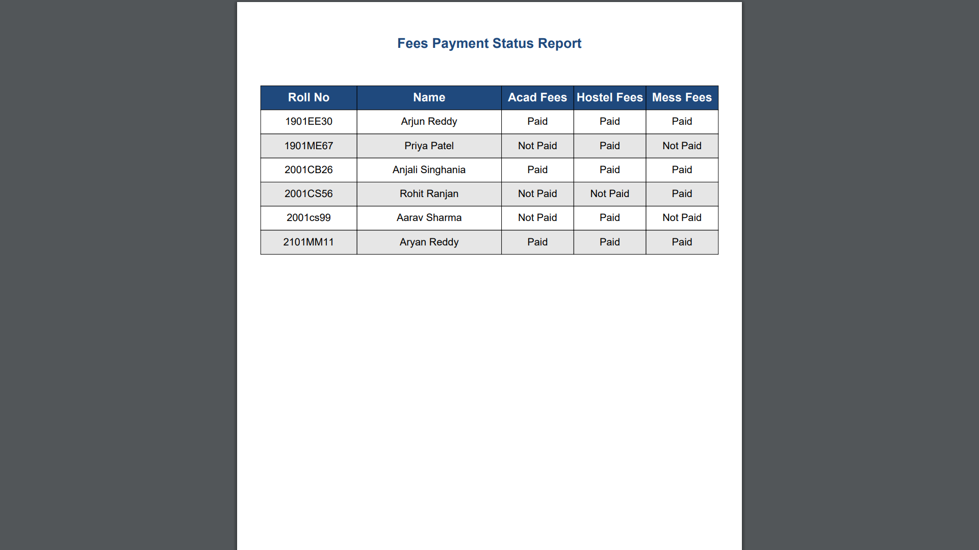

Slide 33
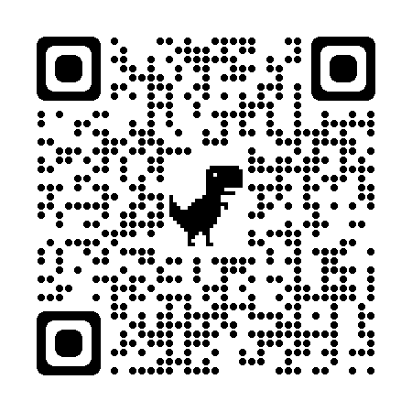
Access Our Application
Deployed URL: https://rr-btp-iitp.000webhostapp.com
GitHub Repository: https://github.com/rohitranjan-rr10/btp

Slide 34
THANK YOU!
Rohit Ranjan
2001CS56

